Slide 1
What is the Metaverse?
By: Sajid Mahmood
PIAIC Roll No: PIAIC53426

Slide 2
Power and Scope of the Metaverse
The internet has always been, and always be a magic box”
–Marc Andreesen
Co-author of Mosaic Web Browser

Slide 3
Classical Hypothesis
The human avatars interacted with each other and software agents in 3D environment. The 3D environment was a metaphor of the real world.
“Snow Crash” Science fiction novel by Neal Stephenson, 1992.

Slide 4
Next Generation Virtual Reality based Internet
Metaverse Realism
A user is so immersed interacting with 3D virtual reality, where emotions and psychological engagement seems natural.

Slide 5
The fully immersive 3D interactions in Metaverse
Sight
Touch
Gestures and Expressions

Slide 6
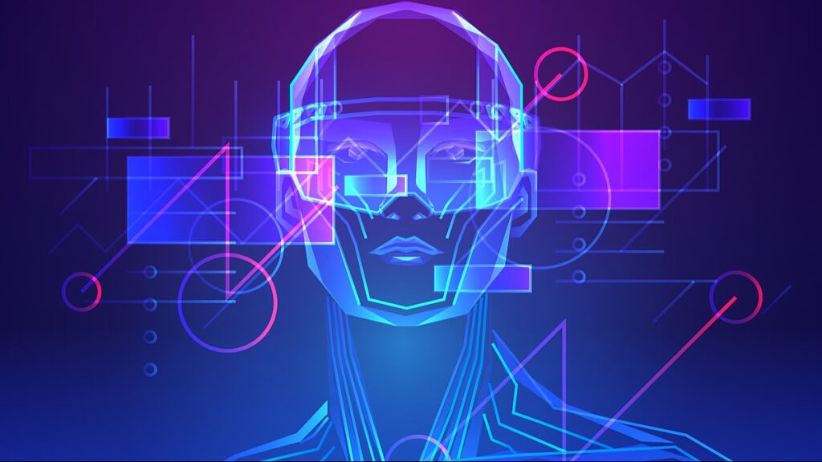
Who owns the Metaverse?
No one, and Every one

Slide 7
Internet VS Metaverse
Metaverse is build on Top of internet
Avatars inside Metaverse

Slide 8
Metaverse Currency
NFT’
Unique digital art
Images
3D Art
Pieces of Music, etc
Signatures
Digital currency OR Cryptocurrency
Decentralized Finance, etc

Slide 9
Metaverse Economy is going to be Decentralized one.
No Banks, No Intermediate Agents, Free and Independent

